Slide 1



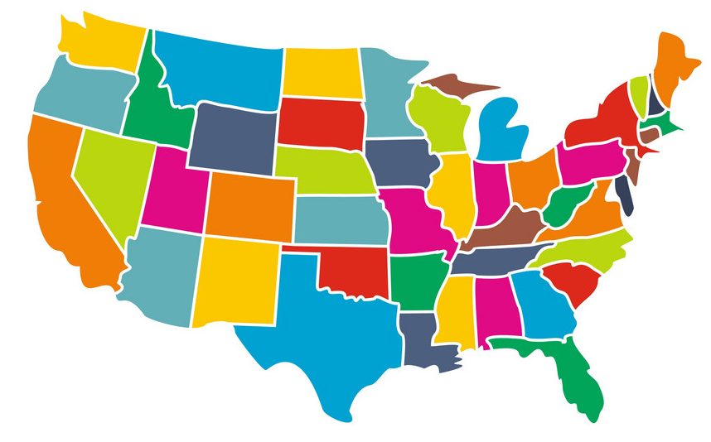
- David Gill Data 606
PREDICTING SALES FOR MULTIPLE WAL-MART STORES

Slide 2

Slide 3
OBJECTIVE
Historical sales data pertaining to 45 Walmart stores located in different regions has been downloaded from
https://www.kaggle.com/c/walmart-recruiting-store-sales-forecasting/data
The goal is to is to predict the department-wide sales for each store and when it would occur.
In addition, Walmart runs several promotional markdown events throughout the year, which precede prominent holidays, the four largest being the Super Bowl, Labor Day, Thanksgiving, and Christmas. The holiday weeks are weighted five times higher, in evaluation than non-holiday weeks.
Part of the challenge would be modeling the effects of markdowns on the holiday weeks in the absence of complete/ideal historical data.

Slide 3
Features.csv - csv file containing additional data pertaining to the stores. The attributes in the file are: - Store number - Date(week) - Temperature (average temp. in the region) - Fuel price in the region - Consumer price index - Unemployment rate - Promotional markdown values - Is a holiday week
DATA SOURCES
1
Stores.csv – csv file containing anonymized information about the 45 stores. Attributes in the file are:
- Store number
- Type
- Size
2
3
Train.csv - csv file containing historical training data, from Feb'2010 to Nov'2012. The attributes in this file are:
- Store number
- Dept. number
- Date(week)
- Weekly sales
- Is a holiday week
4
Test.csv - csv file identical to train.csv, except that there are no weekly sales. Need to predict sales for each triplet of store

Slide 4




METHOD/ APPROACH
R/Python:
Data Cleansing/ Transformation
Exploratory Data Analysis
ML/ Model Construction
CSV Files:
Data Source/
Data Storage
PowerBI/ Tableau:
Visualization of Analysis and Results

Slide 5

CONSEQUENCES/ USES
Budget forecasting/ revenue management
Inventory Control
Planning growth
Making intelligent business decisions

Slide 6


Questions/ Feedbacks
Email: agill2@umbc.edu
Github: https://github.com/DavidGill606/Data606

